Slide 1
Recommender System!!
Presenting by, Nilotpal Pramanik
Under Supervision: Dr.Ranjana Vyas

Slide 2


Introduction
We can get into this topic through discussing three most important question...
What??
Why??
How??

Slide 3
1.
What is Recommender System??
Let’s start with the first most important question...

Slide 4
A recommender system or a recommendation system is a subclass of information filtering system that seeks to predict the "rating" or "preference" or “prioritise” a user would give to an item.As well as through which system an organization can provide more efficient choices and specific informations about its products to an user with respect to his/her age, gender, interest or observed behaviour about item and more other categories.

Slide 5
2.
Why Recommender System??
Now go for the second most important question...

Slide 6
USER’S Aspects!!
Getting reliable and relevant informations before going for any product through the ratings and comments from the previous users.
Save the time to find the desirable one among a lot due to having categories.
Provide a open space to show the preferences to the products.

Slide 7
ORGANIZATION’s Aspects
Analyze the behaviour of the customers.
To provide more improved, accurate and precise results to the users.
Make new or renew the business strategies to optimize their profits.

Slide 8
3.
How Recommender System??
Here is the third most important question...

Slide 9
In modern society is that people have too much options to use from due to the prevalence of Internet. In the past, people used to shop in a physical store, in which the items available are limited. For instance, the number of movies that can be placed in a Blockbuster store depends on the size of that store. By contrast, nowadays, the Internet allows people to access abundant resources online. Although the amount of available information increased, a new problem arose as people had a hard time selecting the items they actually want to see. This is where the recommender system comes in.

Slide 10
RFM CONCEPT
RFM criterion is one of the oldest and most widely used technique for selecting the most significant customers. It supports the selection of customers that are most recent (R), frequent (F), and add a larger monetary value (M) in every transaction.

Slide 11
RFM(Recency,Frequency,Monetary) Analysis
We will tag each customer on a scale of 1 to 5 for each of the criterion where 5 will be the highest and 1 will be the lowest tagging. The customers on the top of all the three criterion will be the most significant customers.
Recency
Recency is the most important predictor of who is more likely to respond to an offer. Customers who have purchased recently are more likely to purchase again when compared to those who did not purchase recently.
On the basis of Date of purchasing...It can be seen that around 2200 customers out of 3900 customers have purchased in last 2 months. Note that some customers have not visited the store in last 4–8 months. To regain that lost customer base, business should look out for the reasons why these customers stop visiting the stores.
Frequency
The second most important factor is how frequently these customers purchase. The higher the frequency, the higher is the chances of these responding to the offers.
On the basis of Month of purchasing...It can be seen that most of the customers are visiting the store less than 13 times a year. Therefore, now it will be interesting to see what the variation is in the Monetary value that these customers contribute.
Monetary Value
The third factor is the amount of money these customers have spent on purchases. Customers who have spent higher contribute more value to the business as compared to those who have spent less.
On the basis of Year of purchasing...It can be seen there is an almost equal distribution of customers as far as monetary value is concerned.

Slide 12
Based on business requirements, various cutoffs are imposed on each of the three parameters. After applying the cut-offs, customers can be classified mainly in three segments:
Customers clearing all the three cut-offs are the best and the most reliable customers. Business should focus on making customised promotional strategies and loyalty schemes for these customers in order to retain this valuable customer base.
Customers failing the recency criterion only are those customers who have stopped visiting the store. Business should focus on these customers and look out for the reason why they abandoned visiting the stores.
Customers clearing the recency criterion but failing frequency criterion are the new customers. Business should provide more incentives and offers to these customers and try to retain these new customers.

Slide 13
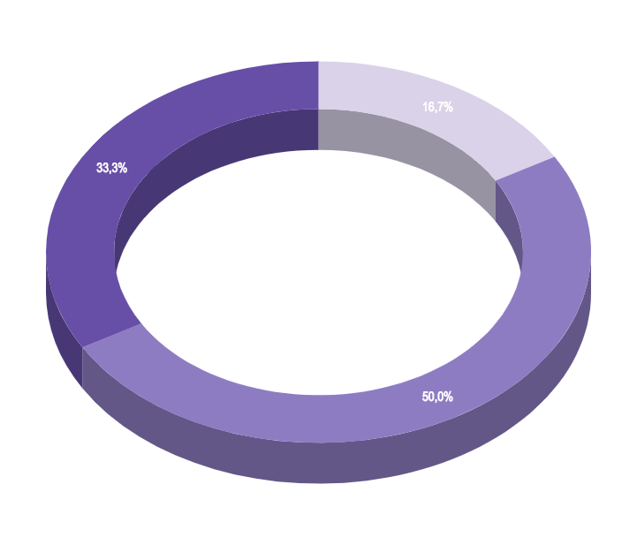
M
Apart from segmenting customers, business can also use RFM criterion to filter out a reliable customer base and perform analysis like Market Basket Analysis to see customer buying pattern or assess the success of marketing strategies by analysing the response of these customers.
F
R

Slide 14
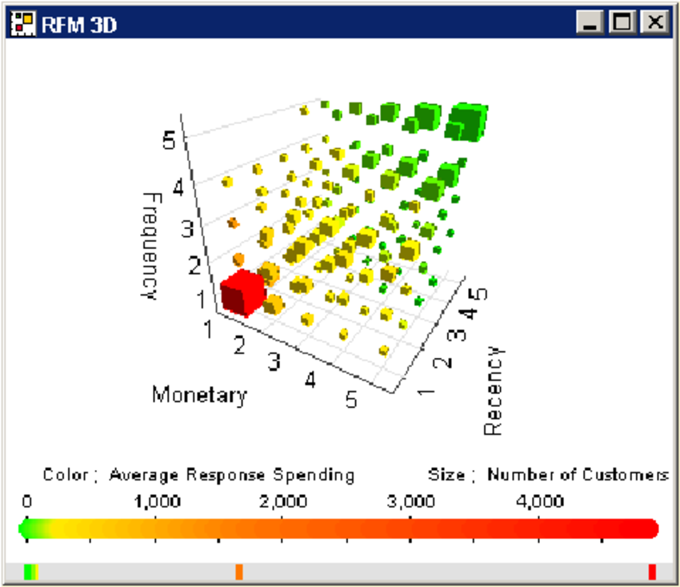
The squares are of different sizes indicating that is a different number of customers in each segment. For instance, there are no squares corresponding to Recency = 1 and Frequency = 5 and Recency = 2 and Frequency = 5 indicating that no customers fall in these segments. The square corresponding to Recency = 1 and Frequency = 1 is larger than its neighbors since it represents a larger segment of the customer base as compared to its neighbors. Marketers are mostly interested in large segments of the customer base with high response spending like the segment with Recency = 1 and Frequency = 1. A 3D scatter plot is used to depict the complete RFM.

Slide 15
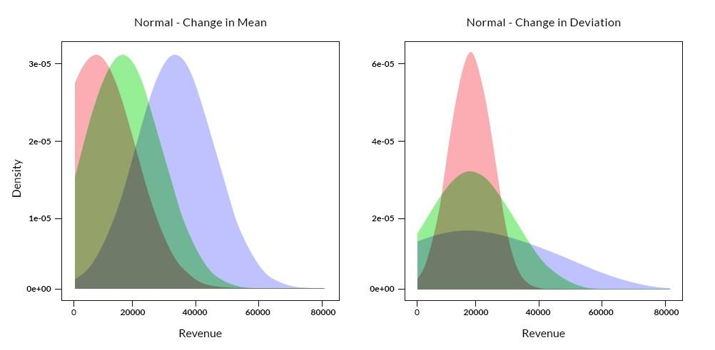
Normal-Change in Mean: If we plot the Change of Mean in each RFM components with respect to the Number of Customers then we find the GAUSSIAN DISTRIBUTION.And for all it’ll rise for comparatively same height.
Normal-Change in Deviation: If we plot the Change of Deviation in each RFM components with respect to the Number of Customers then we again find the GAUSSIAN DISTRIBUTION.But from our previous discussion there is an almost equal distribution of customers as far as Monetary value is concerned.And Recency will vary due to date with large variations so it has a sharp pick.And for the frequency the distribution will lie between them according to our discussion.
RFM
Number of Customers
Number of Customers

Slide 16

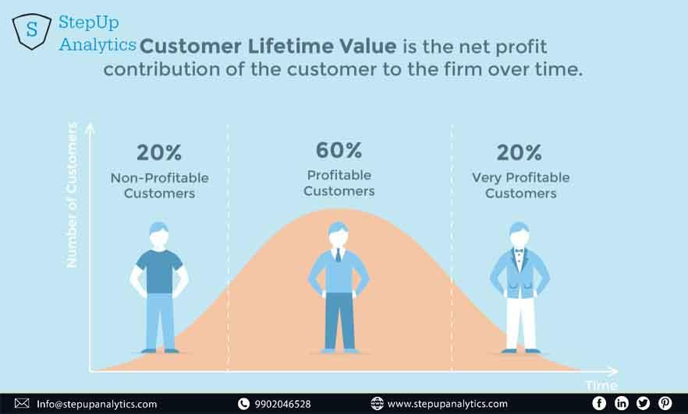
Want big impact?
USE BIG IMAGE.

Slide 17
Non Personalized Recommender System
Whoa! The most basic form of Recommender System

Slide 18
89,526,124$
185,244 USERS
???%
As the name suggests, this recommender system provides with general recommendations to the user without any context of what user wants or what is his/her preferences.
Let’s think of Amazon for example. When we visit the website for the first time, it provides us with a list of most popular item. These popular items can be based on different parameters like geography, age, sex etc. Based on these parameters, system calculates the mean of the product rating of all the users and provides us with the products with maximum mean. This is also called stereotyped recommender system.
Pros: Provide the proper guidance to the new users.
Cons: It may happen that the user needs/likes those items which have less ratings, then??
That’s a lot of money!!
And a lot of users!!
Total success!!

Slide 19
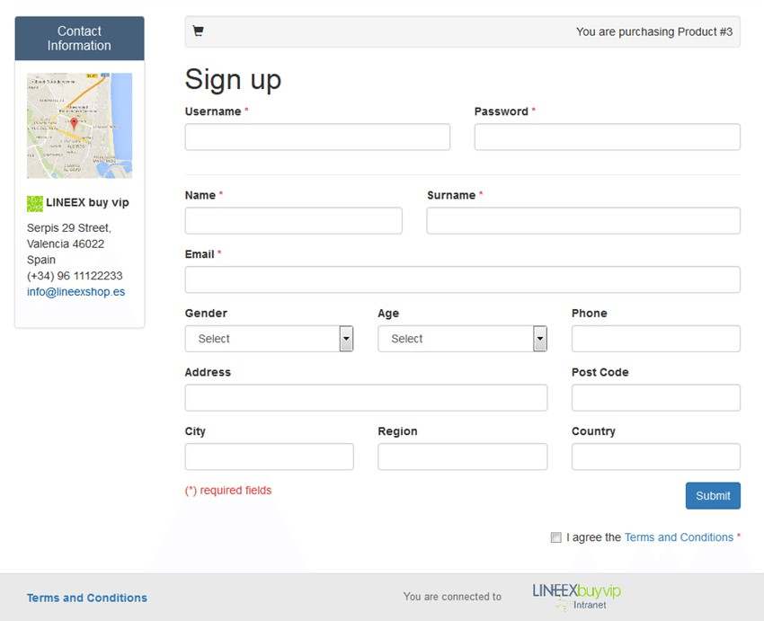
Probable SOLUTION!!
During the Signing Up the along with age, gender, location the organization should provide “You prefer” / “genre” kinda choice list to reach more close to the user’s needs...
Place your screenshot here

Slide 20
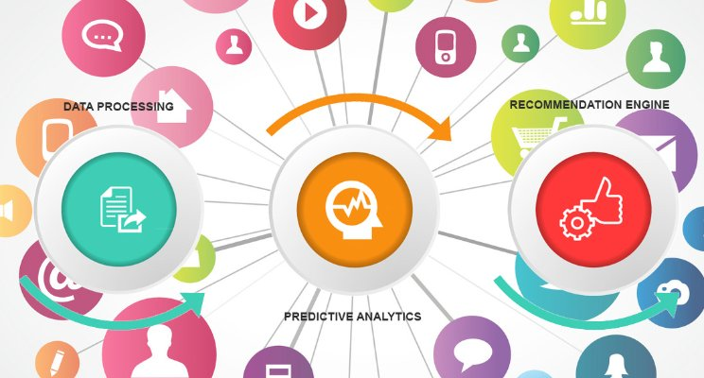
Product Association Recommender
Apart from Stereotyped Recommender System, another class of non personalised recommender system use association to recommend products.
Place your screenshot here

Slide 21



In Product Association Recommenders, uses the knowledge of the product that a consumer is looking at and based on this knowledge, it provides item recommendations. One way of providing these recommendations is to go through all the historical transactions and see what other people have most frequently bought along with the given product in the same sales transaction.
This type of recommendation is not personalized to the person but to current user who is looking at the given product. So how to calculate this?

Slide 22
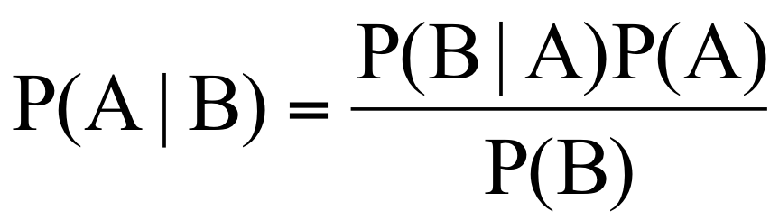
Let us take an example to understand this. Let us suppose that X is Red sauce and Y is Banana. So is it correct saying that 80% of the people who buy Red sauce also buy Banana necessarily? Or does it mean that Banana is a very common product and people will buy it irrespective of the fact whether there is Red sauce in the basket or not??
To control the popularity of Y overwhelm the recommendation, we use the concept of Bayes Theorem….

Slide 23
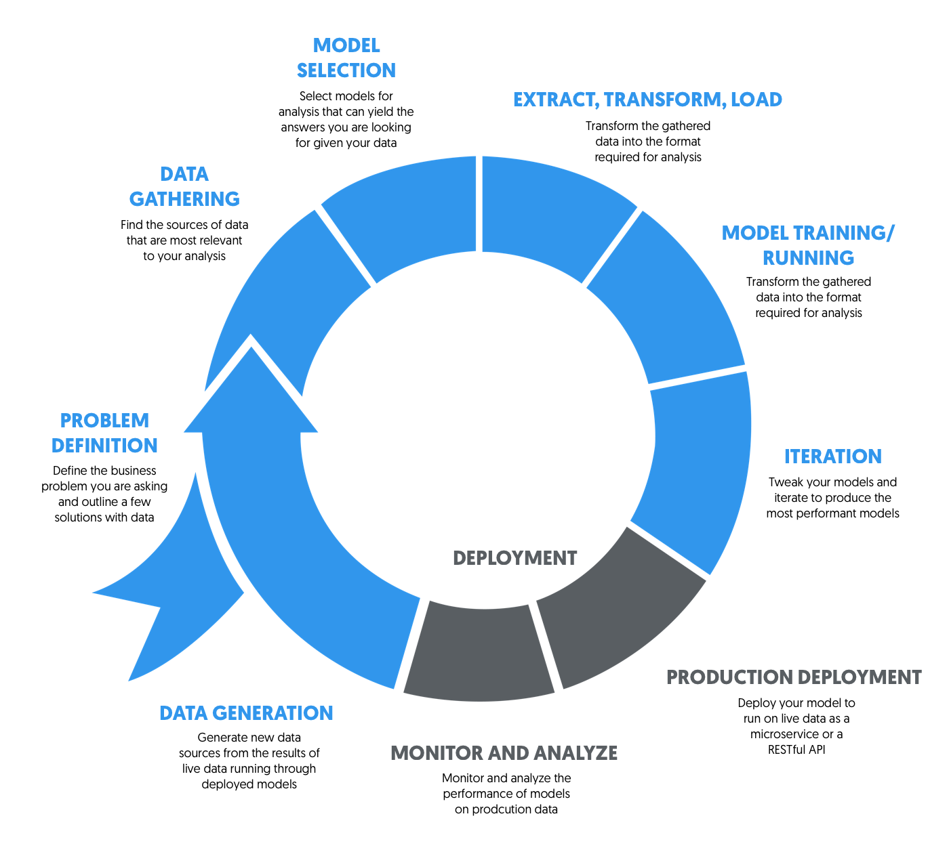

Slide 24
Construction of Recommender System
The two traditional approaches...

Slide 25
Content-based Recommendation
This type of recommender system is dependent on the inputs provided by the user. Some of the typical examples of content based filtering are Google, Wikipedia etc.
Let’s start by getting an intuition of what these recommenders do. When you search a group of keywords, the most basic idea will be to show all the items containing those keywords. But the biggest problem that we are trying to solve here, The problem of Huge Pile of information, acts as a roadblock in this also. For Example, if someone search for “The Recommender System”, there will be a large number of documents containing the Keyword “The”. Same is for the keyword “System”.

Slide 26
Collaborative Filtering
User-User
Let’s move forward from this intuition and incorporate the behaviour of other users and provide more weight to the ratings of those users who are like me. But how do we check how much a user is similar to me?
To answer this, we will use Karl Pearson’s correlation and see how similar two users are. It is usually calculated over the items that both the users have rated in the past. But there is a problem with this approach. When the number of common ratings are not very large, the similarity value gets biased. It might be possible that 2 users have only 2 ratings in common but the value of correlation is very high or even very close to 1.

Slide 27
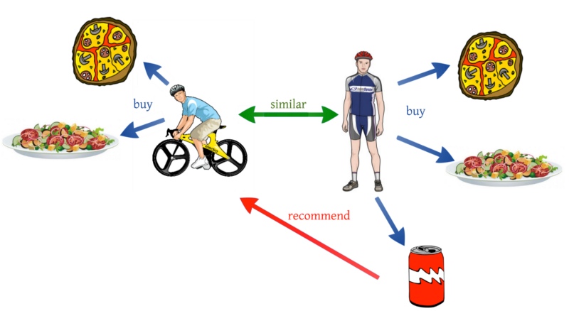

Slide 28
Collaborative Filtering
Item-Item
ITEM-ITEM collaborative filtering look for items that are similar to the articles that user has already rated and recommend most similar articles. But what does that mean when we say item-item similarity? In this case we don’t mean whether two items are the same by attribute like Fountain pen and pilot pen are similar because both are pen. Instead, what similarity means is how people treat two items the same in terms of like and dislike.
This method is quite stable in itself as compared to User based collaborative filtering because the average item has a lot more ratings than the average user. So an individual rating doesn’t impact as much.

Slide 29
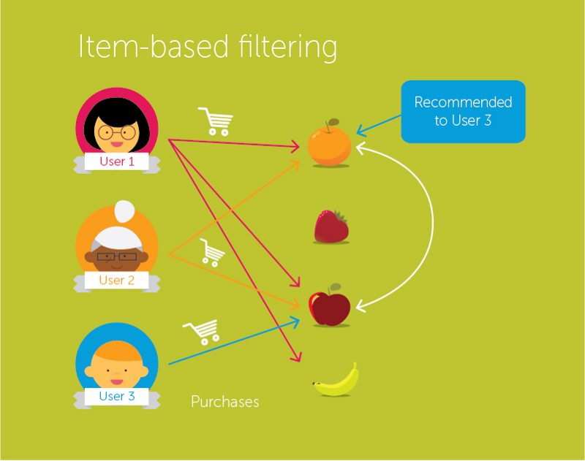

Slide 30








World Wide Applications

Slide 31


THANK YOU:)
You can find me at:
nilotpal.npk@gmail.com
&&
https://www.facebook.com/nilotpal.pramanik.96

